Slide 2
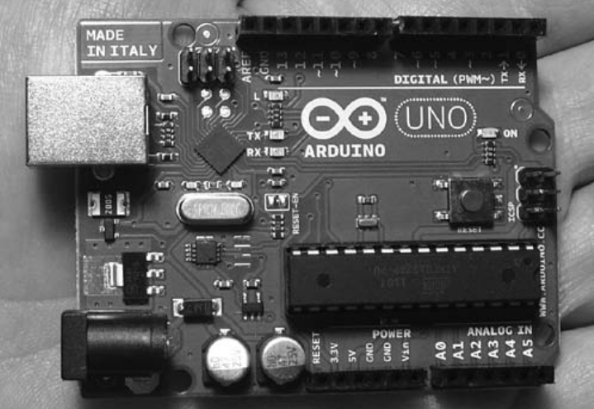
What is Arduino ?
The Arduino is a tiny computer system that can be programmed with your instructions to interact with various forms of input and output

Slide 3
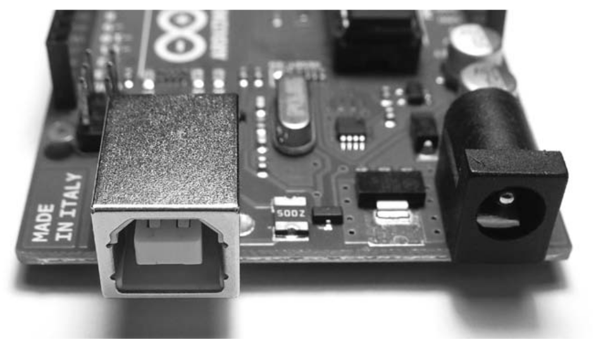
Quick Tour of Arduino
USB Connector
Connects Arduino to Computer
To Supply Power
Upload Instructions to Arduino
Send and Receive Data

Slide 4
Quick Tour of Arduino
Power the Arduino with DC 9-12V plug

Slide 5
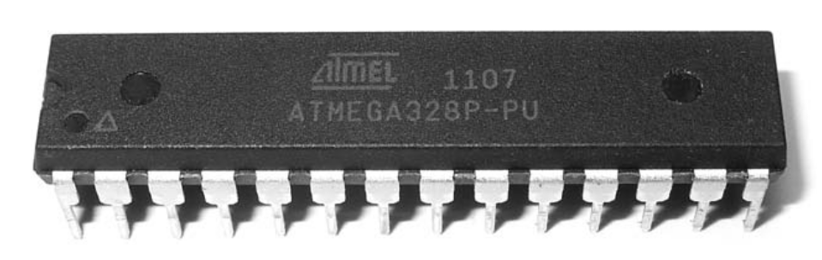
Quick Tour Arduino
MicroController
Brain of the Arduino
Executes Instructions
Contains Memory

Slide 6
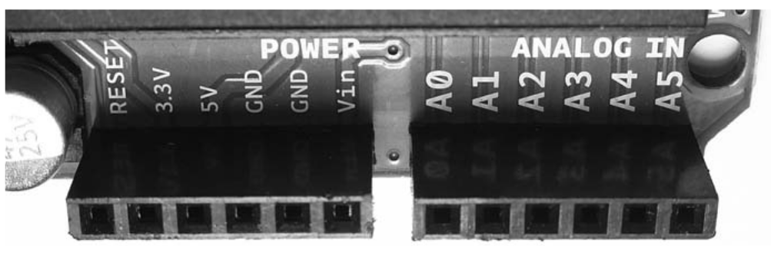
Quick Tour Arduino
Analog Inputs
Six Analog In Pins
Measure Electrical Signals vary in voltage

Slide 7
Quick Tour of Arduino
Power Connections
External RESET

Slide 8
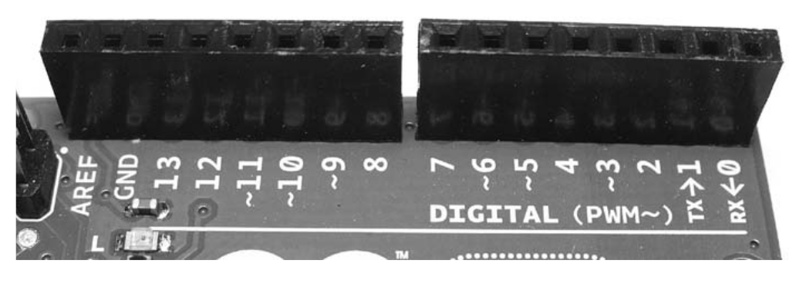
Quick Tour of Arduino
Digital Input and Output Pins
Detect the prescence of signal or Can Generate on Command
‘ ~ ‘ Labelled pins can generate varying electrical signal

Slide 9
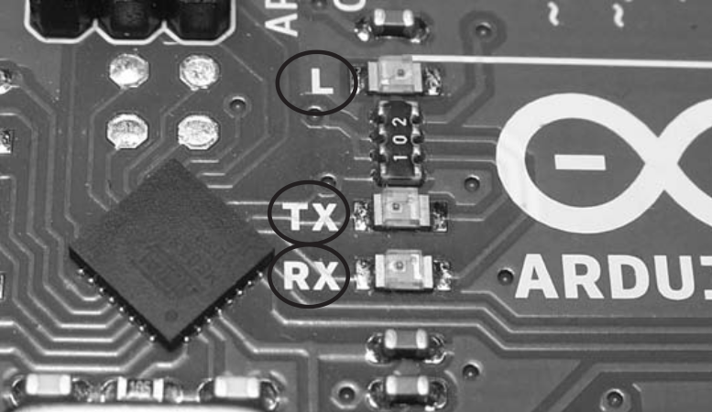
Quick Tour of Arduino
On Board Led’s
TX, RX light up when Data being Transmitted and Received
L is connected to Digital Pin 13

Slide 10
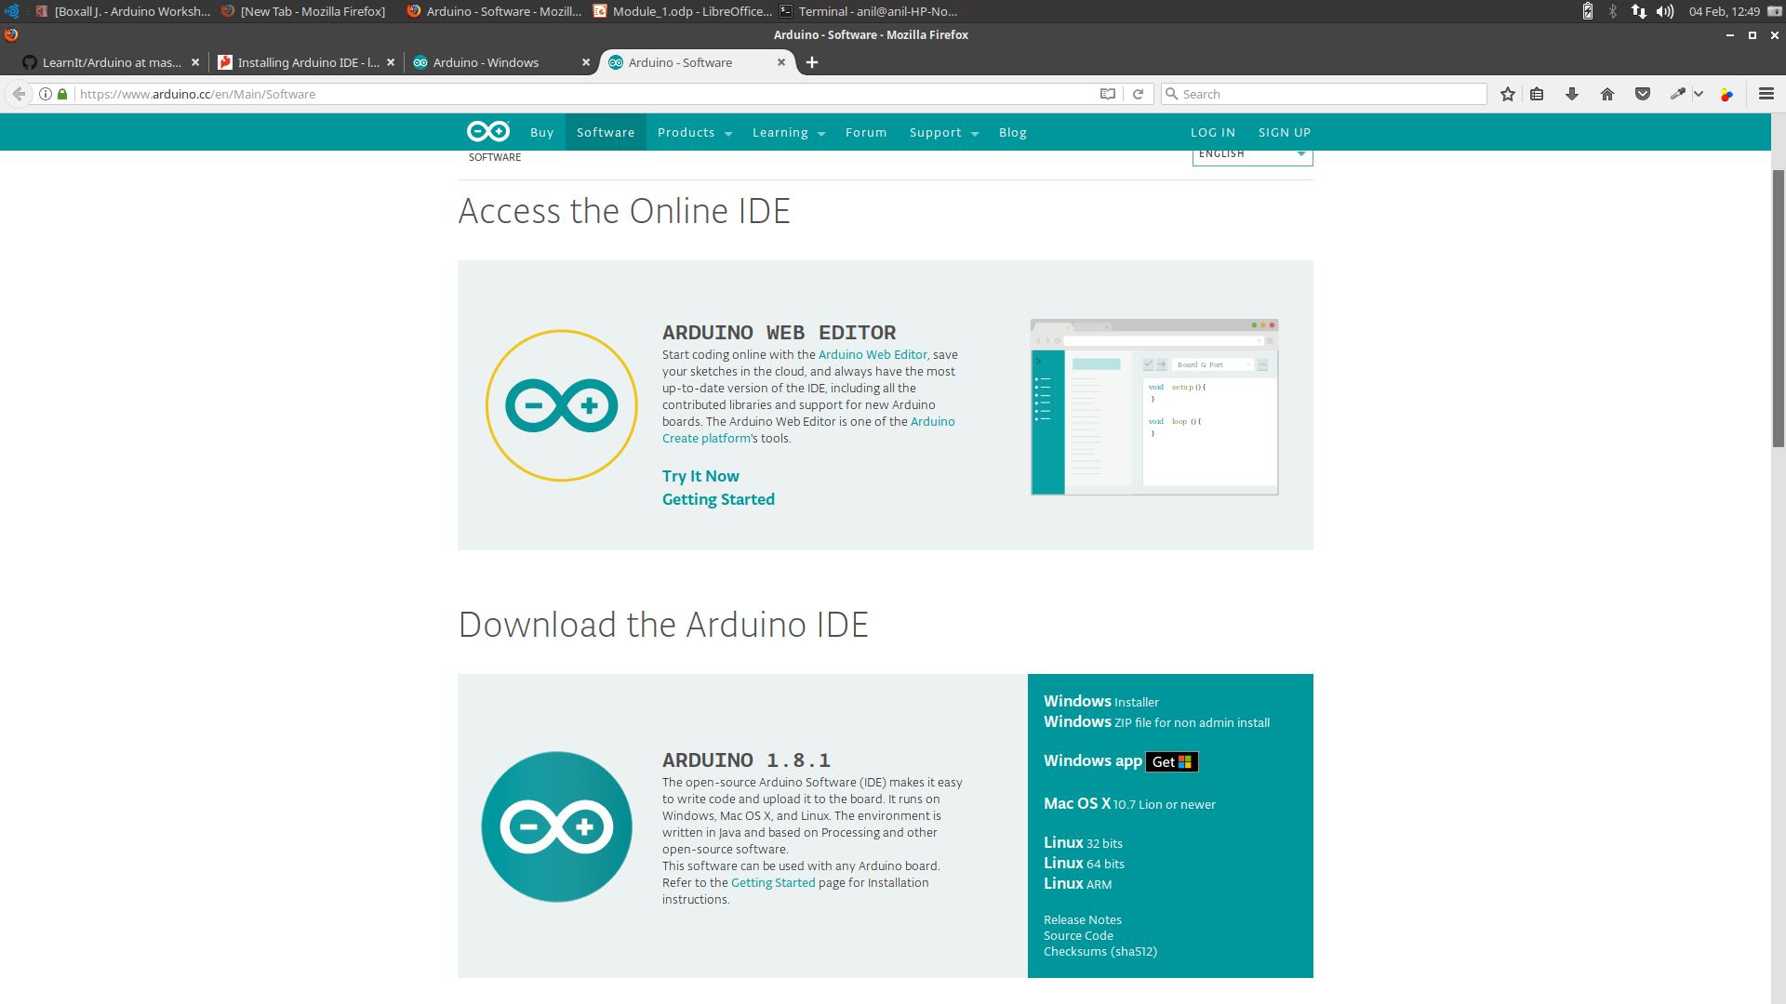
Software - Download
Arduino.cc/en/Main/Software
Select Installer

Slide 11
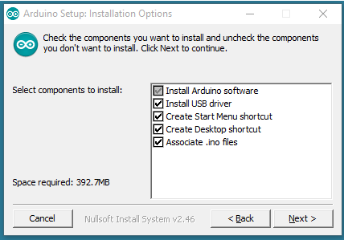
Installation
Double click on the Downloaded Exe File
Allow OS to install Drivers

Slide 12
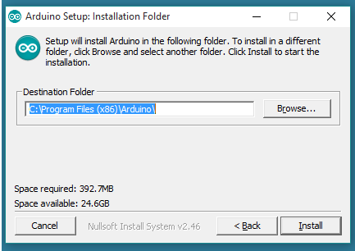
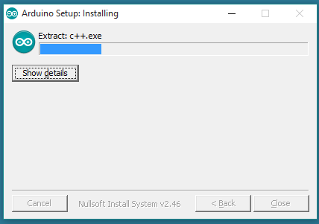
installation

Slide 13

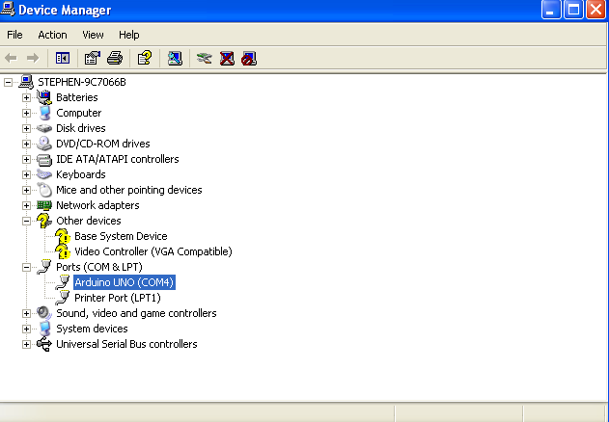
Installation - Driver
Connect Arduino to Computer using USB Cable
Open Device Manger
Look under Ports
Note Arduino UNO COM port

Slide 14
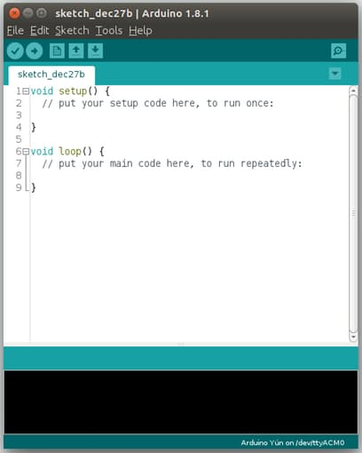
IDE – Test Run
Double Click on the Arduino Icon in Desktop
The Tab is known as Sketch
It Contains the program that tells your board what to do

Slide 15
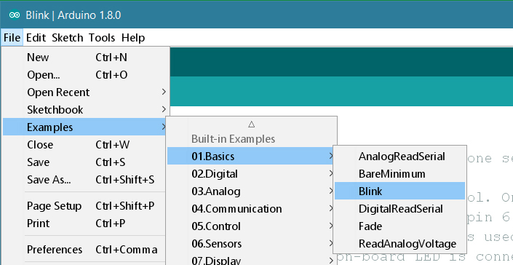
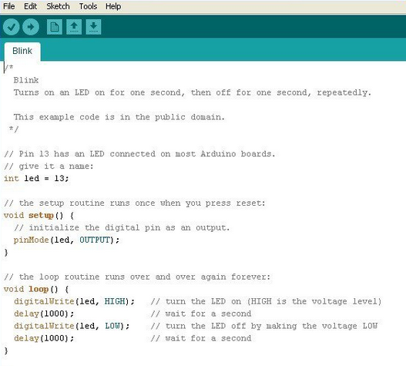
Test Run - Blink It
Go to File->Examples-> Basics-> Blink and click on it

Slide 16
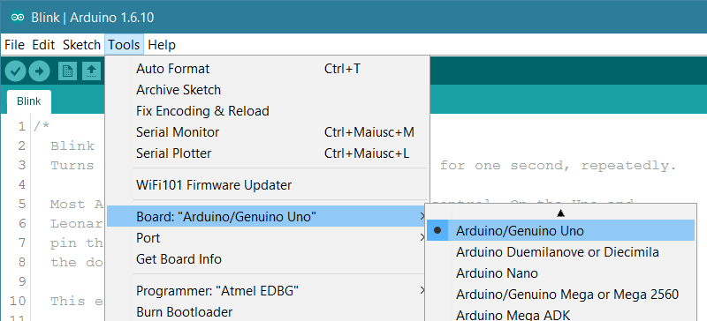
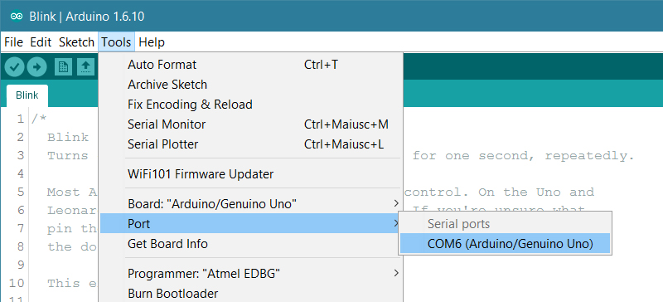
Test Run - Blink It
Select Board type in Tools -> Board
Select UNO
Select COM port noted Previously in Tools -> Port

Slide 17
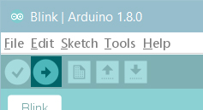
Test Run - Upload
Click the upload button
you should see the RX and TX leds on the board flashing
After few seconds on board led blinks

Slide 18
Introduction to Arduino Programming

Slide 19
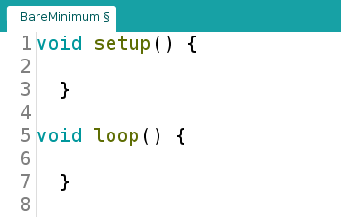
Structure
Every Program must contain these two functions
Setup is preparation
it is the first function to run and run only once
Loop is execution
it is executed continuesly

Slide 20
Fuctions
Function is block of code that has a name and a block of statements when the function is called
Setup() and loop() are built-in functions
- we will talk about custom functions later

Slide 21
Basic Syntax
Each Statement Ends with semicolon “;”
int a = 13;
Curly braces always come in pairs; they are used to define the start and end of functions, loop, conditional statements
// is used for single line comment
/* */ used to wrap multiline comment

Slide 22
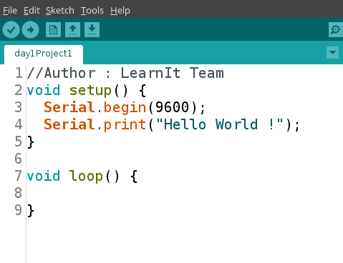
Hello World
Usb is used to send and Receive Data Serially
Serial Port / Com port talks with certain speed, called Baudrate

Slide 23
Hello World
Serial.begin(9600) basically tells the Arduio to start talking over serial port at a speed of 9600 baud
Baudrate – Bits per second

Slide 24
Hello World
Serial.print tells the Arduino to send a text line to Serial port
Notice the Semicolon (;) - every statement must end with semicolon

Slide 25
Select Port and Board
Select Board type in Tools -> Board
Select UNO
Select COM port noted Previously in Tools -> Port

Slide 26
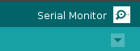
Upload & Open Serial Monitor
Upload the Sketch
Observe the tx & rx blinking on Board
Click on the magnifying glass to open Serial Monitor

Slide 27
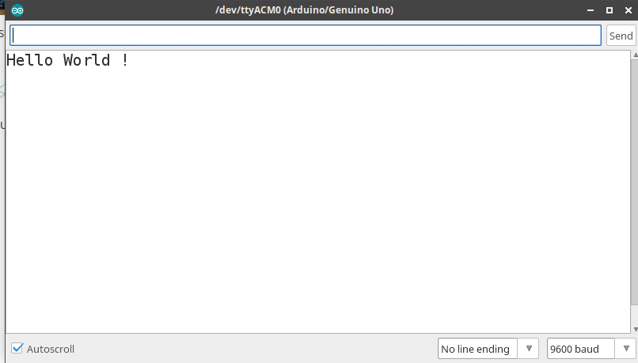
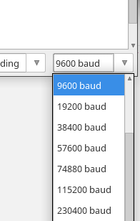
Try with Differnt Baudrates by changing in Serial.begin and Serial Monitor

Slide 28
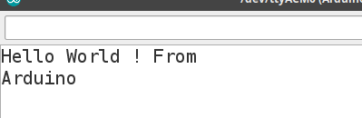
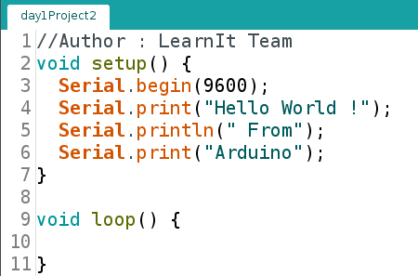
Print vs println
“Arduino “ Starts in new line But “From” is on same ine

Slide 29
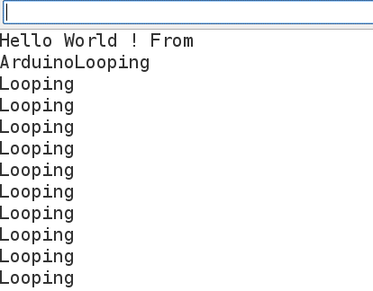
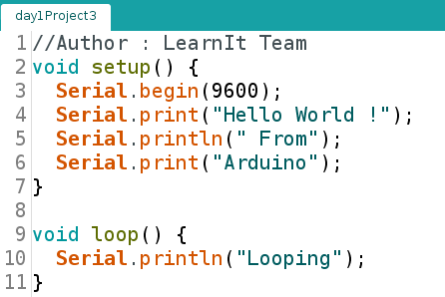
Setup vs loop
Statement in loop is repeting

Slide 30
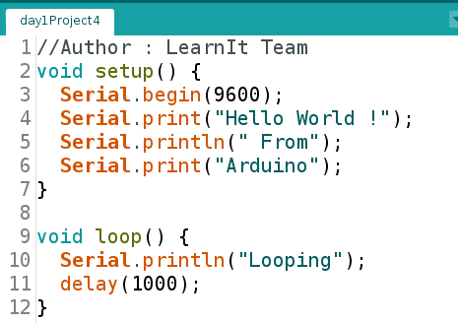
Delay
Delay Pauses the program for the amount of time (in miliseconds) specified as parameter
it brings all other activities to a halt

Slide 31
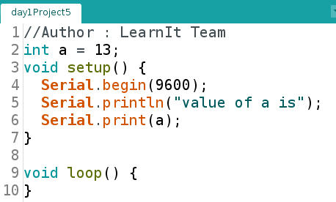
Variables
A variable is a place to store a piece of data
It has a name, a value, and a type
int a = 13;
creates a variable whose name is a, whose value is 13, and whose type is int

Slide 32
Variable types & Rules
consist of any letters (a to z and A to Z)
contain the numbers 0 to 9, but may not start with a number, e.g. 3var is not allowed, but var3 is allowed
Variables may not have the same names as Arduino language keywords, e.g. you can not have a variable named int
Variables must have unique names i.e. you can not have two variables with the same name
Variable names are case sensitive, so Count and count are two different variables
Variables may not contain any special characters, except the underscore (_), e.g. top_score
Type | Description
int | Integer max size is 2^8
float | Floating point value
char | Character
String | String

Slide 33
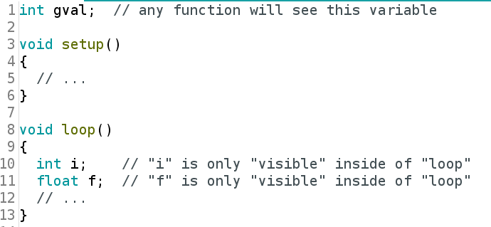
Variable Scope
scope is the lifetime and visibility a variable has in a program
Global : A variable with global scope is visible from its point of definition to the end of the file in which it is defined
Local : A variable with local scope extends from its point of definition to the end of the function block in which it is define

Slide 34
Arithmetic operators
Symbol | Name | Example | Explanation
= | assignment | Led = 13 | Store the value 13 at variable led
+ | addition | A = B + C | Add the variable B,C and assign the result to C
- | subtraction | A = B - C | Subtract C from B and assign the result to A
* | multiplication | A = B*C | Multiply B and C and assign the result to A
/ | division | A = B/C | Divide B with C and assign the result to A
% | modulo | A = B%C | Calculate the Remainder of division B/C and assign it to the A

Slide 35
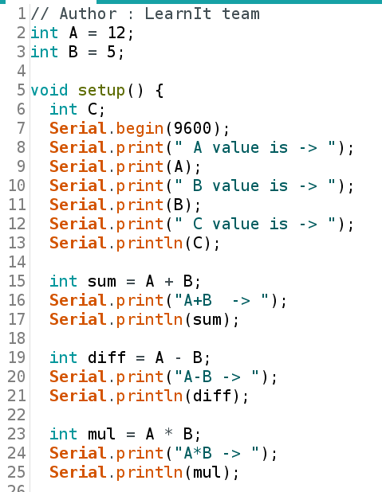
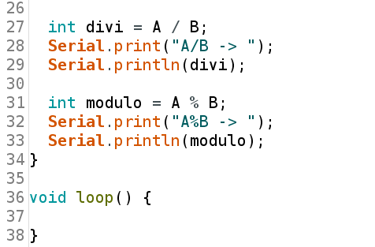

Slide 36
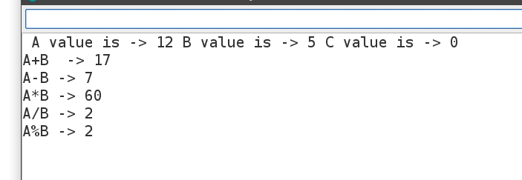

Slide 37
Comparison Operators
Result of statement with comparision operator is either TRUE or FALSE
0 < x < 1 is invalid
Symbol | Name | Example | Explanation
== | Is equal to | X == Y | X is equal to y
!= | Not equal to | X != Y | X is not equal to Y
< | Less than | X < Y | X less than Y
> | Greater than | X > Y | X greater than Y
<= | Lessthan or equal to | X <= Y | X less than or equal to Y
>= | Greater than or equal to | X >= Y | X greater than or equal to Y

Slide 38
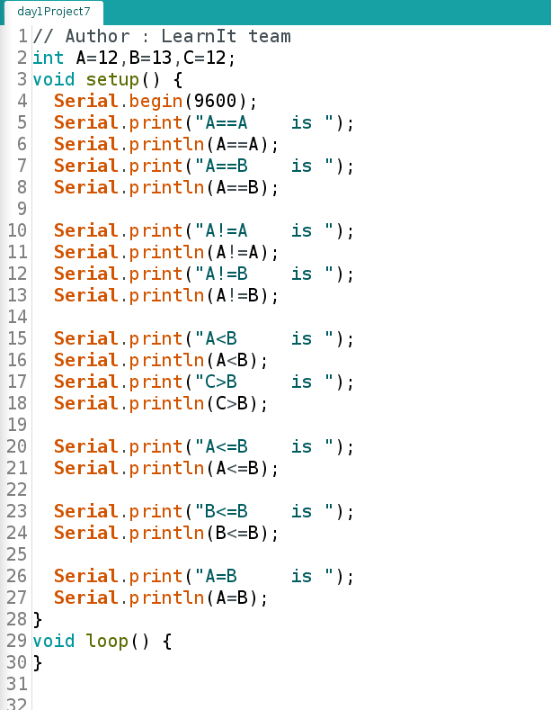

Slide 39
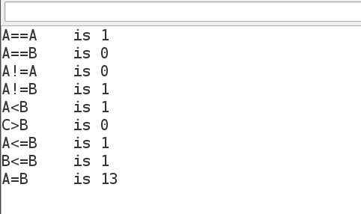

Slide 40
Boolean Operators
Symbol | Name | Example | Explanation
&& | Logical AND | X>Y && Y<Z | True only if both conditions are true
|| | Logical OR | X>Y || Y< Z | True if any one of condition is true
! | NOT | !X | Invert the boolean value X

